Slide 1
Predictive Maintenance of Water Pumps in Tanzania
Enhancing Service Delivery Through Data Science, by Leonard Koyio

Slide 2
1. Introduction
Overview: This project focuses on using data science to enhance the maintenance of water pumps in Tanzania.
Importance: Functional water pumps are crucial for reliable water supply, especially in rural areas.
Goal: Our aim is to predict the status of water pumps to ensure timely and efficient maintenance.

Slide 3
2. Business Understanding
Business Objective: Assist the Tanzanian government in optimizing water pump maintenance by predicting pump functionality, ensuring consistent access to clean water for communities.
Business Problem: Inefficient allocation of maintenance resources due to a lack of predictive insights, leading to over-servicing functional pumps and under-servicing those needing repairs, increasing costs and water supply disruptions.

Slide 4
2. Business Understanding
Business Benefits
Improved Resource Allocation: Prioritize critical units, optimize resource use, and enhance service delivery by focusing efforts on pumps needing immediate attention.
Cost Savings:Reduce repair costs and extend pump lifespan through preventative maintenance, leading to significant long-term savings.
Enhanced Water Access: Ensure better access to clean water, vital for public health, by reducing non-functional pumps and improving water service reliability.

Slide 5
2. Business Understanding
Data-Driven Decision Making: Foster a culture of data-driven strategies, improving efficiency in water pump maintenance and setting a precedent for other public services.
Improved Service Delivery: Targeted and efficient maintenance approach reduces downtime and ensures quicker repairs, enhancing public trust and satisfaction with government services.

Slide 6
3. Data Understanding
Dataset Description: The dataset includes information on various features influencing the status of water pumps.
Key Features:
GPS Height: Elevation of the pump location.
Age: Age of the water pump.
Population: Population served by the pump.
Extraction Type: Type of extraction method used.
Quantity Group: Water quantity availability (e.g., seasonal, insufficient, enough).

Slide 7
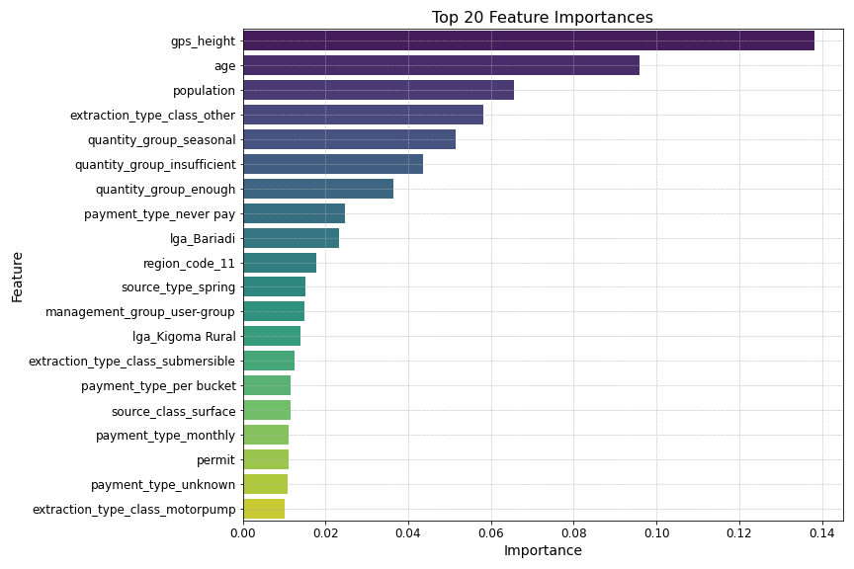
Visualization : top 20 model features

Slide 8
4. Exploratory Data Analysis (EDA)
Data Cleaning:
Remove Redundant Columns: Eliminated columns with no predictive value or columns with repeated data to streamline the dataset.
Handle Missing Values: Filled zeros and NaNs with suitable data, such as median or mean values, to maintain data integrity.
Data Transformation:
Min-Max Scaling: Applied Min-Max Scaling to normalize the range of independent variables, ensuring all features contribute equally to the model.
One-Hot Encoding: Converted categorical variables into binary vectors to allow the model to interpret them effectively.
Feature Engineering:
Age of the Pump: Calculated the age of each pump by subtracting the installation year from the current year, providing a crucial feature for predicting functionality.

Slide 9
5. Modeling
Baseline Models:
Developed initial models using Logistic Regression and Decision Trees with default hyperparameters to establish a performance benchmark.
Iteratively tuned models based on performance metrics.
Class Imbalance Handling:
Class Weights: Adjusted weights to handle class imbalance within the model.
SMOTE: Used Synthetic Minority Over-sampling Technique to balance class distribution by generating synthetic samples for the minority class.

Slide 10
5. Modeling
Model Regularization:
L1 Regularization: Promotes sparsity by driving some coefficients to zero, improving model interpretability.
L2 Regularization: Penalizes large coefficients to reduce overfitting, enhancing model generalizability.
Decision Tree Tuning:
Criteria: Compared Gini and Entropy criteria to determine the best split quality measure.
Max Depth Optimization: Tuned the maximum depth parameter to prevent overfitting and improve model performance.

Slide 11
6. Model Evaluation
Settled Model: Decision Tree trained on dataset without outliers.
Class Imbalance Handling: SMOTE to balance class distribution.
Criterion: Gini impurity criterion.
Max Depth: None specified.
Metrics:
Weighted Recall: 0.7128
Indicates that the model correctly identifies 71.28% of instances, considering class distribution, which is critical for ensuring non-functional and repair-needed pumps are detected.
Weighted Precision: 0.7443
Shows that 74.43% of the positive predictions are correct, reflecting high accuracy in identifying pumps needing attention.

Slide 12
6. Model Evaluation
Weighted F1 Score: 0.7253
Balances precision and recall, ensuring the model is effective in both identifying and accurately predicting pump statuses.
ROC AUC Score: 0.7626
Measures overall performance; a score of 0.7626 indicates a good balance between sensitivity and specificity, which is suitable for our objective of predictive maintenance.

Slide 13
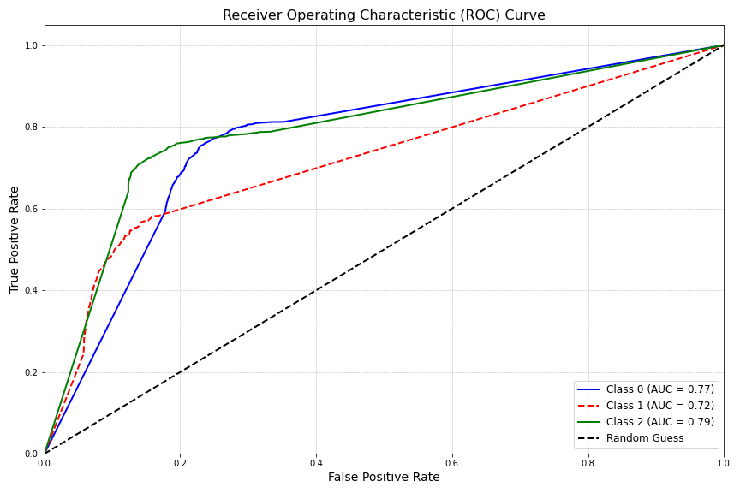
7. Model Visualizations : a. ROC Curve
Class 2 (Non-Functional): High AUC of 0.79 ensures accurate identification of out-of-service pumps, crucial for timely repairs.
Class 1 (Needs Repair): AUC of 0.72 indicates good detection of pumps needing maintenance, preventing further issues.
Class 0 (Functional): AUC of 0.77 helps confirm operational pumps, reducing unnecessary checks and optimizing resource use.

Slide 14
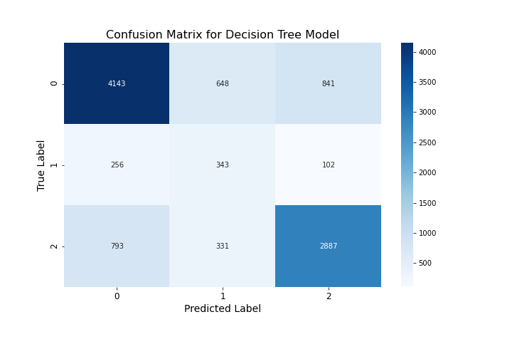
7. Model Visualizations : b. Confusion Matrix
Key
0 - Functional
1- Functional Needs Repair
2- Non- Functional
The model is well-balanced, with no strong bias towards any class, ensuring fair consideration of all pump statuses.

Slide 15
8.Predictive Recommendations
Model Utility:
Most Useful: In rural or remote areas where quick maintenance decisions are crucial. Helps prioritize repairs and maintenance.
Less Effective: In rapidly changing conditions or where historical data is outdated.
Suggestions for Improvement:
Data Accuracy: Ensure accurate and up-to-date data on pump conditions and maintenance.
Feature Engineering: Add features related to usage patterns, maintenance history, and environmental conditions.

Slide 16
9. Project Impact
Improved Maintenance Efficiency: Enables timely repairs and consistent water supply.
Cost-Effective Resource Allocation: Optimizes budget use and reduces unnecessary expenses.
Scalability and Adaptability: Easily adapts to include more features or updated data.

Slide 17
10. Conclusion
Project Success:
Developed a robust predictive model that categorizes water pumps as functional, needing repair, or non-functional using data from Taarifa and the Tanzanian Ministry of Water.
Directly addresses the need for efficient water pump maintenance in Tanzania.
Model Advantages:
Accuracy: The Decision Tree Classifier delivers reliable predictions, essential for timely maintenance decisions.
Efficiency: Enhances maintenance scheduling and reduces downtime, ensuring consistent water supply.
Cost-Effectiveness: Optimizes resource allocation and minimizes expenses by identifying priority pumps for repair.
Scalability: Easily adaptable to incorporate new data or features, supporting ongoing infrastructure management.
Stakeholder Value:
For the Government: A critical tool for optimizing water infrastructure management and aligning with national goals for improved water access.
For Citizens: Ensures reliable access to clean water, contributing to enhanced community well-being.

